Slide 1
Sources of Tree-ring Count Estimation Error:
Measurement of coring height. In this project, measurement uncertainty was especially high in the Forest patch of the RMB (control) site due to mature tree growth form (i.e., tree trunks emerged from tangled, moss-covered “sets” of tightly-clumped trees and ran horizontally for three to six meters before abruptly becoming vertical), and in the Burned Forest patch of the LC (altered) site due to deep Sphagnum lawns and high water tables, which made tree bases inaccessible.
Estimates of the number of tree-rings not captured by tree cores that were extracted above the root/shoot boundary (see slide 4 for illustration). Following widely accepted methods in the dendrochronology literature, destructively-sampled young trees were used to derive ‘ring count’ x ‘height on stem’ regressions to estimate, based on coring height, how many additional rings should be added to the number of rings tallied within a tree core (see slide 5). This method rests on the assumption that the growing conditions affecting young tree growth reflect conditions experienced during the early life of cored trees. In this study, that may generally hold true within the Forest, Bog Forest and Transition patches (based on observed comparisons of ring widths between tree cores and cross-sections), but not for the Burned Forest patch where the younger trees established under open conditions and have much wider tree-rings than those observed in the tree cores taken from the older snags (see slide 6).

Slide 2
Estimates of the number of tree-rings not captured by tree cores that missed the pith. Another widely-accepted method within the dendrochronology literature includes following the approach of Duncan (1989) to estimate the rings to pith based on, 1) assumed geometric relationships between the height and length of the innermost tree-ring of the core and the missing length of the core that would have reached the pith, and 2) the average width of the three innermost intact rings (see slides 8 and 9). This method assumes that curvature of the innermost tree-ring is fairly strong (i.e., around half of the ring is present ), but see slide 10, and that the widths of the innermost intact rings are representative of tree-rings from earlier in the tree’s life. As you can see in slide 11, there can be quite a bit of variability in ring width across a tree-ring record. On the other hand, there are also some trends by patch (e.g., in the Bog Forest patch, innermost rings tend to be widest, slide 12, while the opposite trend is observed in the Transition and Burned Forest patches). Interestingly, in the dendro. literature, coring height corrections seem to be treated unproblematically while cores that miss the pith are often reported as “minimum age” cores – with only the number of rings counted directly included in the analysis – unless ring-to-pith estimates are under a certain arbitrary threshold number of rings (e.g., 10).
Tree cores missing the outermost rings (due to core damage during collection, transport or processing, or due to weathering in the case of dead trees). In this study, all of the older, pre-fire trees in the Burned Forest patch were snags at the time of coring. Thus, for this patch, I only have minimum age samples for the older cohort of trees.

Slide 3
Rings-to-Coring-Height Estimates

Slide 4
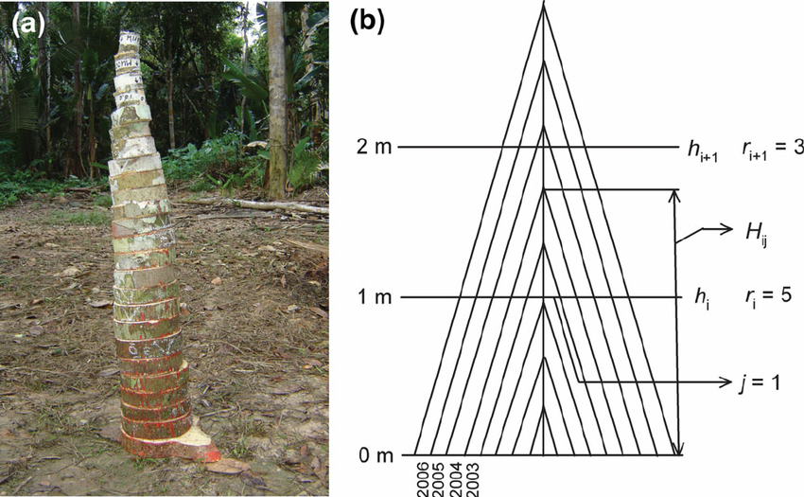
https://www.researchgate.net/figure/Reconstruction-of-height-growth-from-tree-ring-counts-on-discs-collected-at-various_fig1_281686228

Slide 5
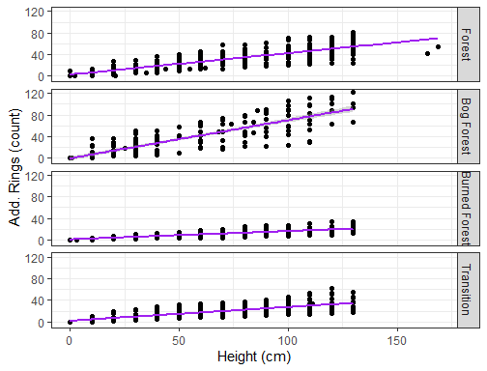
R² = 0.79
RMB
R² = 0.75
R² = 0.71
LC
R² = 0.60
Figure x. Ring count by height (i.e. position along stem from the tree base) for harvested Pilgerdodendron uviferum
(n = 37, Forest; n =24 Bog Forest; n = 23 Burned Forest; n = 22 Transition). Stems were cut into 2 cm wide cross-sections
every 10 to 20 cm starting at the tree base. Cross-sections were sanded to a fine polish, scanned at high resolution,
and imported into CooRecorder for ring delineation/counting.

Slide 6
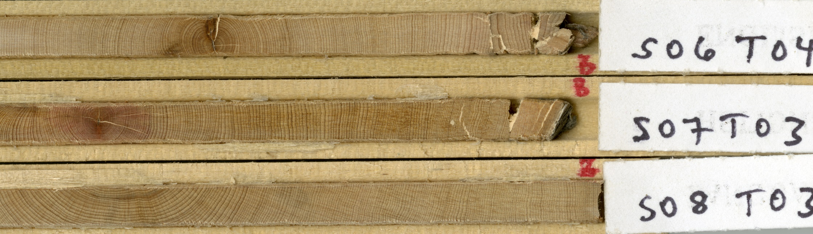
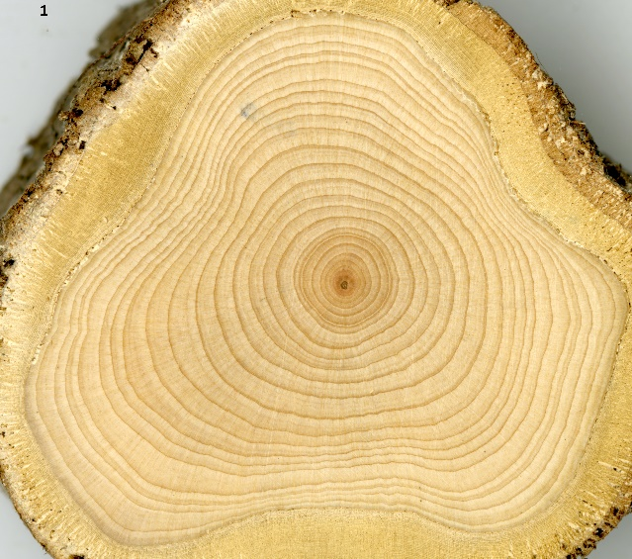
Tree cores (above) and harvested cross section (left) from P. uviferum individuals in the Burned Forest patch at the LC site.
Harvested tree S0602

Slide 7
Rings-to-Pith Estimates
Duncan (1989)

Slide 8
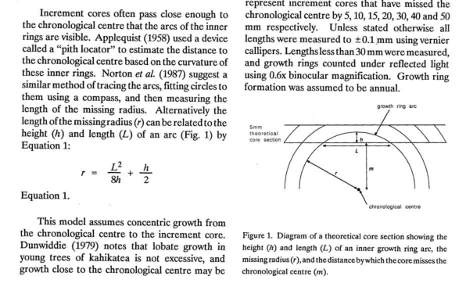

Slide 9
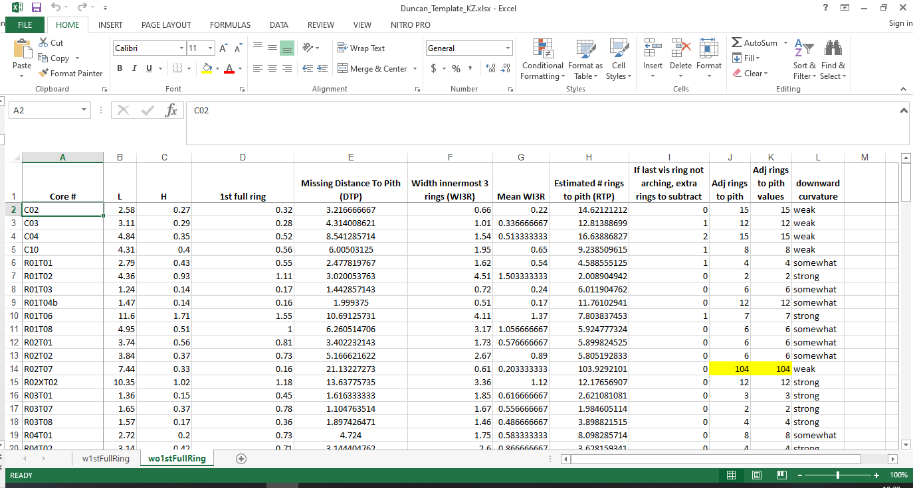
= B2^2 / (8*C2) + C2/2 [-D2]
= E2/G2

Slide 10
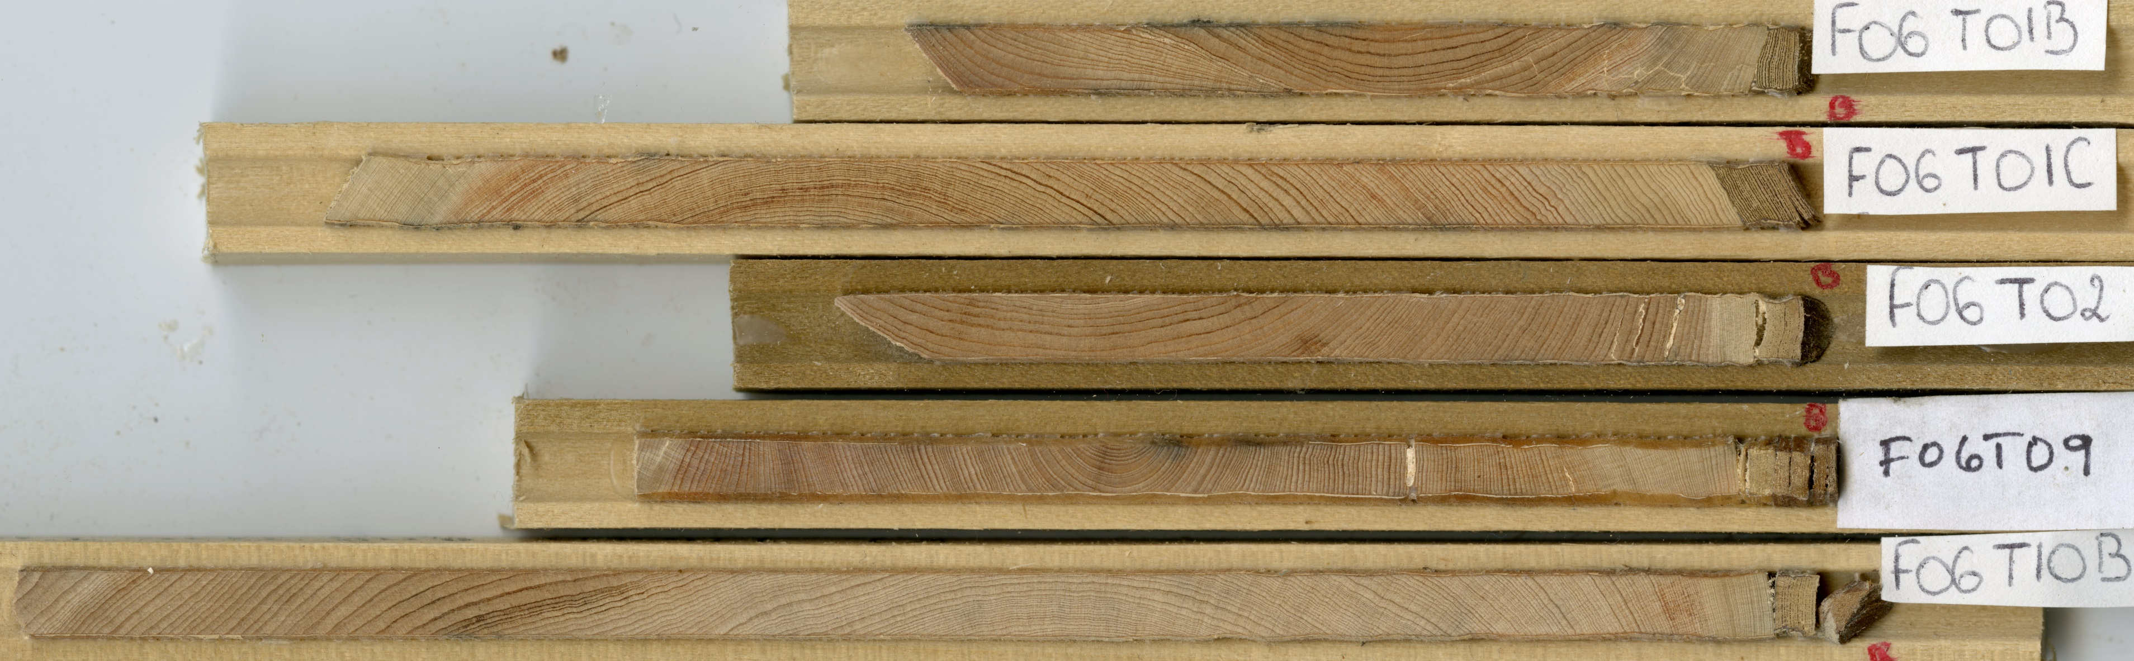
F05T08a; “strong” innermost ring curvature; 17 rings to pith (RTP) estimated; also note how ring width varies across this portion of the core.
F06T01c, “somewhat” innermost ring curvature; 86 RTP estimated;
F06T02, “somewhat”, 28 RTP estimated;
F06T09, “strong”, 9 RTP estimated

Slide 11
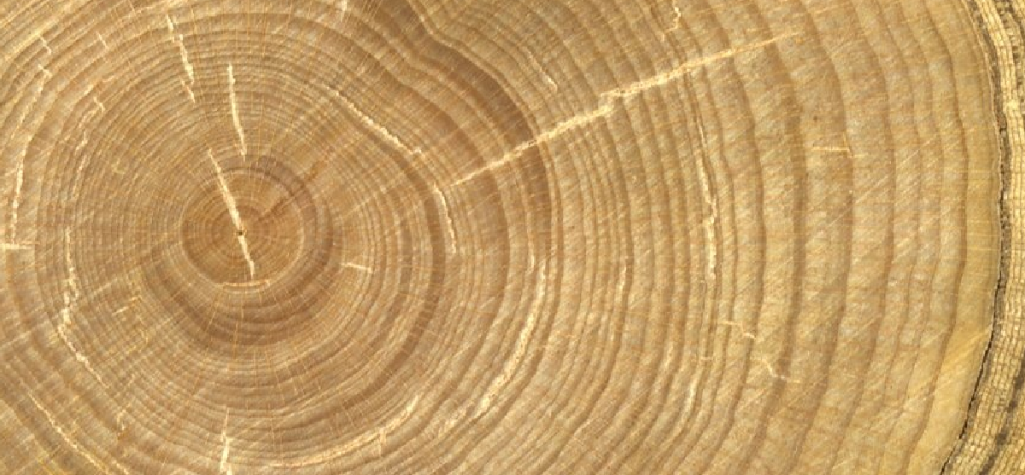
Variable ring widths across cross section F0203_0 from Forest patch.

Slide 12
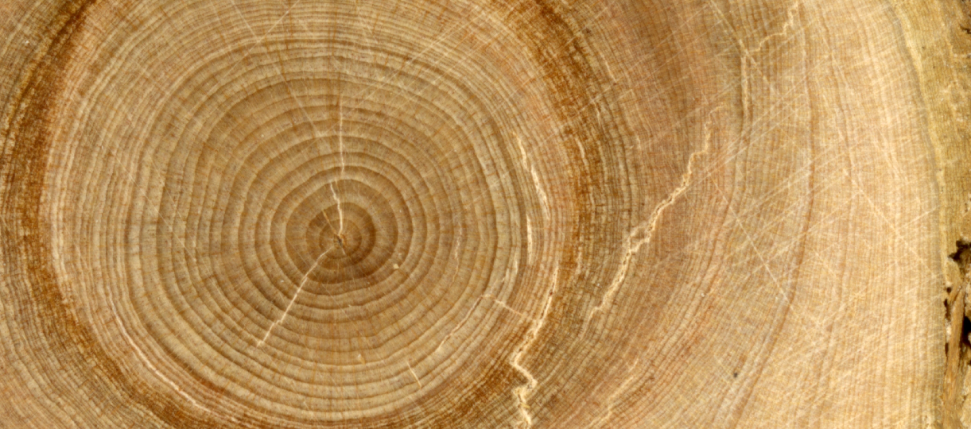
In the Bog Forest patch, rings closer to the pith tend to be wider than rings closer to the bark. This cross section (BF0301_0) represents a particularly dramatic example of that trend.

Slide 13
Qualitative Accuracy of
Tree Establishment Dates

Slide 14
Decision Tree for Qualifying the Accuracy of Tree Establishment Dates
Processed Tree Core
Pith
No Pith
All Rings Present
Missing Outer
Rings
Outer Rings Present
Missing Outer
Rings
Coring Height
Accuracy
High
Coring Height
Accuracy
Low
Duncan RTP
< Upper Threshold
Duncan RTP
> Upper Threshold
Coring Height
Accuracy
High
Coring Height
Accuracy
Low
High CHA, Pith
Low CHA, Pith
Minimum age
High CHA, Duncan
Low CHA, Duncan
Minimum age
Minimum age

Slide 15
Table x. Qualitative categories of tree establishment date accuracy based on accuracy of ring
counts (i.e., radial accuracy) and coring height measurements.
Radial Accuracy | Coring Height Accuracy
 | High, Med | Low
Pith | High CHA, Pith | Low CHA, Pith
Duncan | High CHA, Duncan | Low CHA, Duncan
Minimum Ageª | Minimum age
ªLarge section of rings missing (e.g., outermost rings) or Duncan method estimated more than __ rings to pith.
High CHA, Pith
>
High CHA, Duncan
>
Low CHA, Pith
>
Low CHA, Duncan
>
Minimum age

Slide 16
Exploring estimated rings to pith (Duncan 1989) to determine upper threshold number of rings to add to direct ring counts

Slide 17
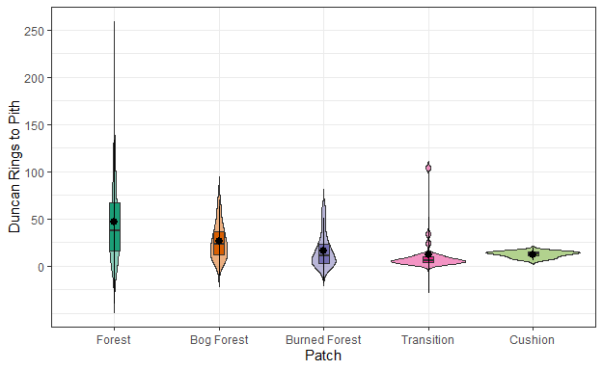
Counts of Rings to Pith Estimated using Duncan (1989) method
(All Tree Cores Missing Pith)

Slide 18
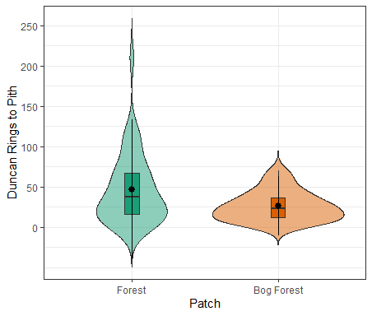
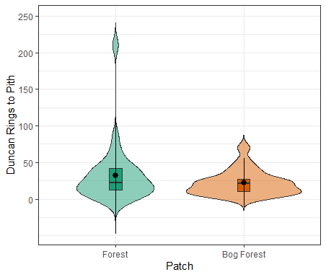
Rings to Pith by Patch for Old-Growth Site (RMB)
All Tree Cores Without Pith
Only Tree Cores With Stronger
Ring Curvature

Slide 19
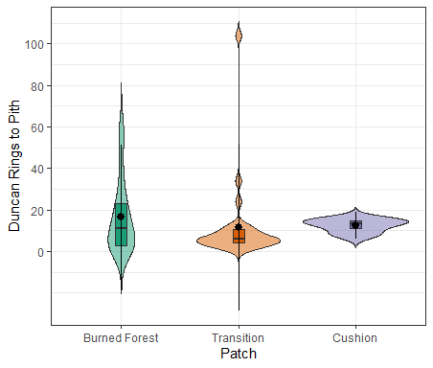
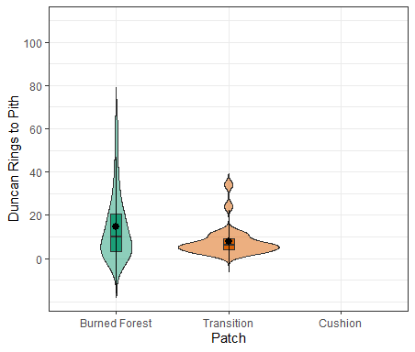
Rings to Pith by Patch for Altered Site (LC)
All Tree Cores Without Pith
Only Tree Cores With Stronger
Ring Curvature

Slide 20
Table x. Estimated rings to pith (RTP; Duncan 1989) summary statistics and upper threshold values for maximum number of estimated rings to add to counts of directly observed rings. Statistics in parentheses pertain to pith-absent tree cores for which the quality of ring curvature was “strong” or “somewhat” (as opposed to “weak”). RTP upper threshold, mean = mean + 2 * SD; RTP upper threshold, median = median + 2 * MAD.
Site, Patch | N | Mean | SD | Median | Median Absolute Deviation | RTP Upper Threshold, Mean | RTP Upper Threshold, Median
RMB, Forest | 39 (27) | 46.90 (32.45) | 43.44 (40.02) | 38.0 (22.0) | 37.06 (23.72) | 133.78 (112.49) | 112.12 (69.44)
RMB, Bog Forest | 31 (23) | 26.29 (21.96) | 18.22 (16.78) | 23.0 (21.0) | 16.31 (14.83) | 62.73 (55.52) | 55.62 (50.66)
LC, Burned Forest | 23 (22) | 17.7 (15.91) | 17.66 (15.8) | 13 (12) | 14.83 (12.6) | 53.02 (47.51) | 42.66 (37.2)
LC, Transition | 28 (27) | 11.04 (7.59) | 19.47 (7.00) | 6 (6) | 4.45 (4.45) | 49.98 (21.59) | 14.9 (14.9)
LC, Cushion | 4 (0) | 12.5 (NA) | 3.32 (NA) | 13.5 (NA) | 2.22 (NA) | 19.14 (NA) | 17.94 (NA)
Median/MAD, strong curvature
(most conservative)
Median/MAD, all curvature
(middle of the road)
Mean/SD, all curvature
(least conservative)

Slide 21
Table X. Overview of P. uviferum tree cores. [LC numbers based on Patch2 assignments]
Site, Patch | Trees cored | Cores processed (live, dead) | With pith (live, dead) | With outermost rings (live, dead) | With pith & outermost rings (live, dead) | Within Plot
RMB, Forest | 49 | 41 (41, 0) | 0 | 36 (36, 0) | 0 | 35
RMB, Bog Forest | 44 | 41 (41, 0) | 10 (10, 0) | 35 (35, 0) | 8 (8, 0) | 21
LC, Transition | [ ] | 51 (43, 8) | 23 (20, 3) | 43 (43, 0) | 20 (20, 0) | 39
LC, Burned Forest | 49 | 41 (5, 36) | 18 (0, 18) | 5 (5, 0) | 0 | 29
LC, Cushion | 10 | 10 (10, 0) | 6 (6, 0) | 10 (10, 0) | 6 (6, 0) | NA
Totals: | 199 | 184 | 55 | 129 | 34 | 124

Slide 22
Models of ring counts by cross-section height of harvested trees to use for
correcting coring heights of tree cores

Slide 23
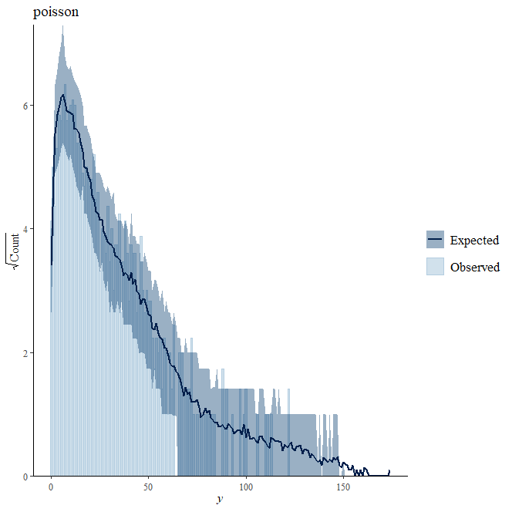
V1: Model of total additional rings relative to the root-shoot boundary for heights of ring count > 0
AddRings ~ Patch + (1 | Sapling) + (1 | Plot), offset = log (Height_RC),
family = poisson, link = “log")
stan_glmer
family: poisson [log]
formula: AddRings ~ Patch + (1 | Sapling) + (1 | Plot)
observations: 1121
------
Median MAD_SD
(Intercept) -0.547 0.089
PatchBurned Forest -1.298 0.131
PatchForest -0.355 0.119
PatchTransition -0.77 0 0.133
Error terms:
Groups Name Std.Dev.
Sapling (Intercept) 0.328
Plot (Intercept) 0.160
Num. levels: Sapling 105, Plot 31

Slide 24
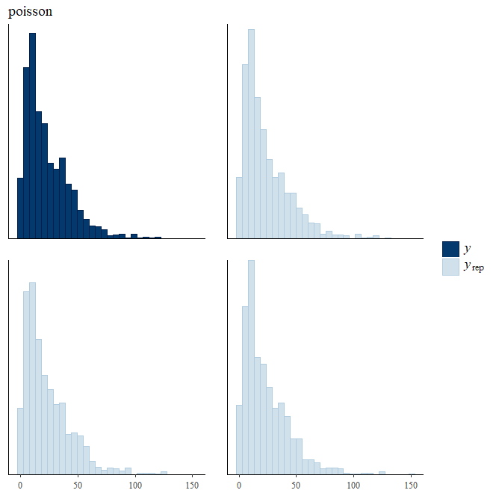
V1: Model total additional rings relative to the root-shoot boundary: Height RC > 0

Slide 25
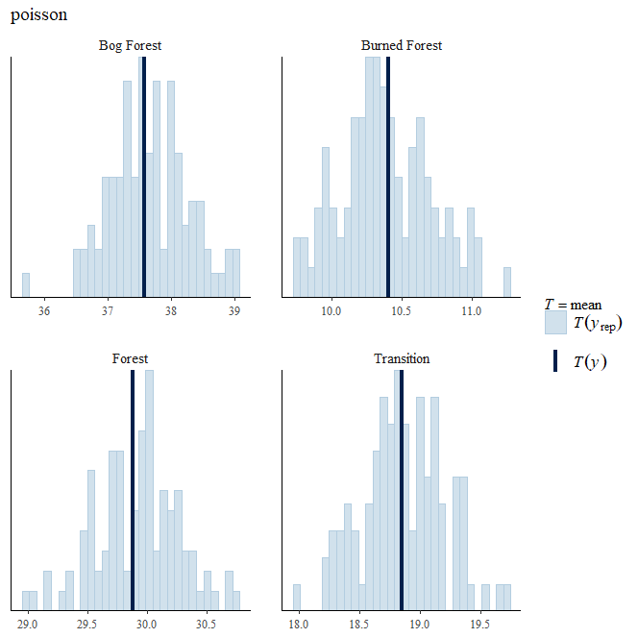
V1: Model total additional rings relative to the root-shoot boundary: Height RC > 0

Slide 26
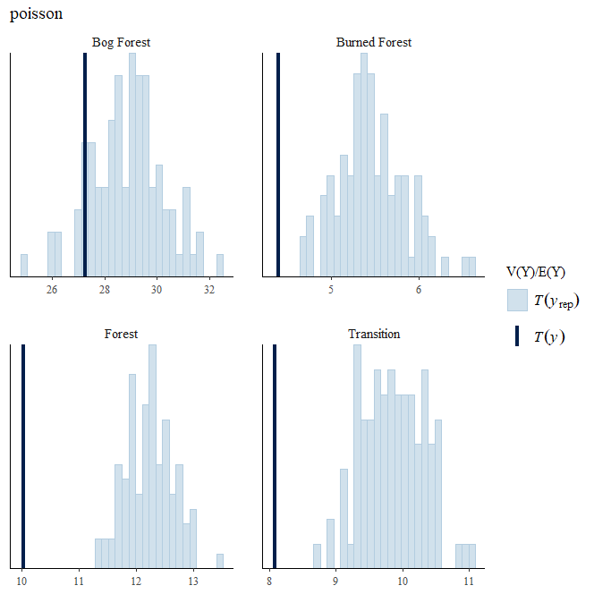
V1: Model total additional rings relative to the root-shoot boundary: Height RC > 0
Dispersion

Slide 27
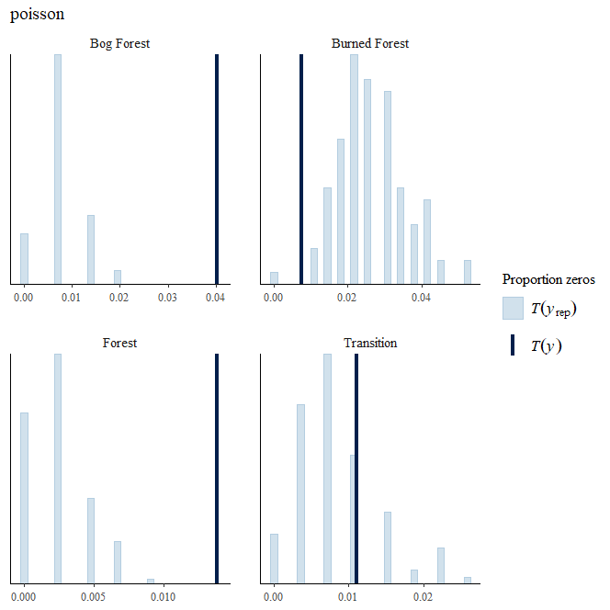
V1: Model total additional rings relative to the root-shoot boundary: Height RC > 0

Slide 28
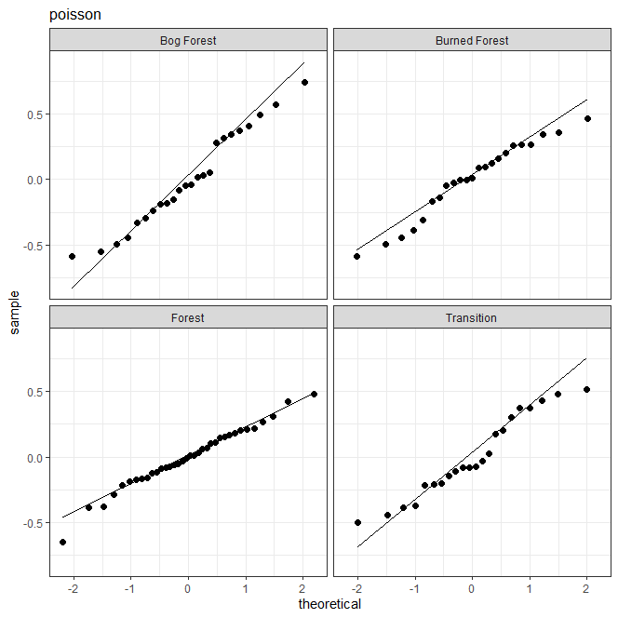
V1: Model total additional rings relative to the root-shoot boundary: Height RC > 0
Normal QQ plot of tree-level
random intercept point estimates

Slide 29
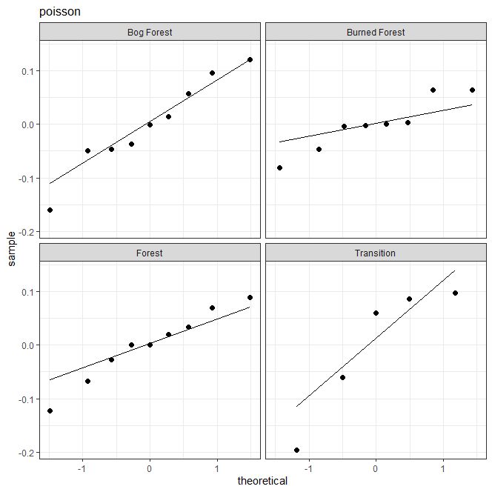
V1: Model total additional rings relative to the root-shoot boundary: Height RC > 0
Normal QQ plot of plot-level
random intercept point estimates

Slide 30
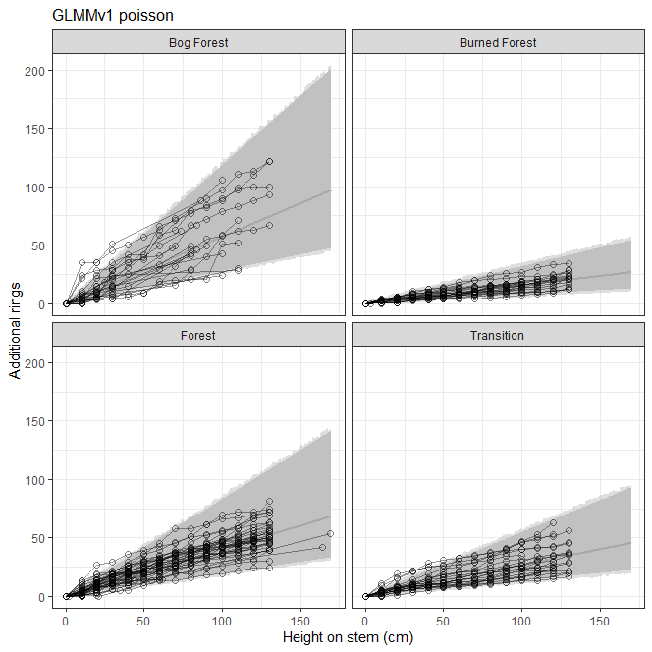
V1: Model total additional rings relative to the root-shoot boundary: Height RC > 0
Additional rings vs. height, grouped by patch; overlay of posterior distribution (median and 95% credible interval) of expectation and PPD
darker gray = predata, pre_epred stats;
lighter gray = predata, pre_ppd_stats
harv_GLMMv1_fits.png

Slide 31
Questions for Buhle:
lines 152+ re fitdata for inverse-link transformed linear predictor and PPD as function of height and patch; use “new” level of grouping factors to marginalize over plot- and tree-level variance (predictions are for “random tree in a random plot”); interpreting harv_GLMMv1_fits.png

Slide 32
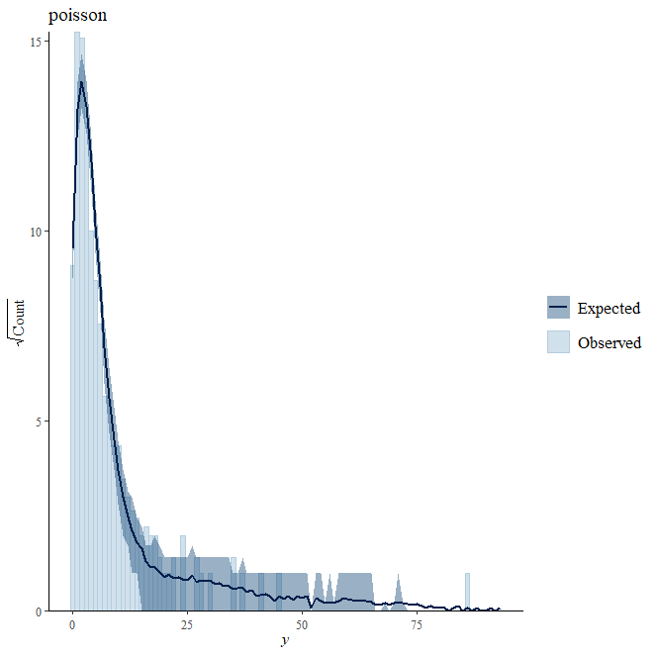
V2a: Model the difference in ring count from one section to the next (incremental ring counts are a priori independent);
likelihood = Poisson
stan_glmer
family: poisson [log]
formula: DiffRings ~ Patch + (1 | Sapling) + (1 | Plot)
observations: 1113
------
Median MAD_SD
(Intercept) -0.504 0.083
PatchBurned Forest -1.305 0.126
PatchForest -0.453 0.113
PatchTransition -0.834 0.130
Error terms:
Groups Name Std.Dev.
Sapling (Intercept) 0.2497
Plot (Intercept) 0.1838
Num. levels: Sapling 105, Plot 31

Slide 33
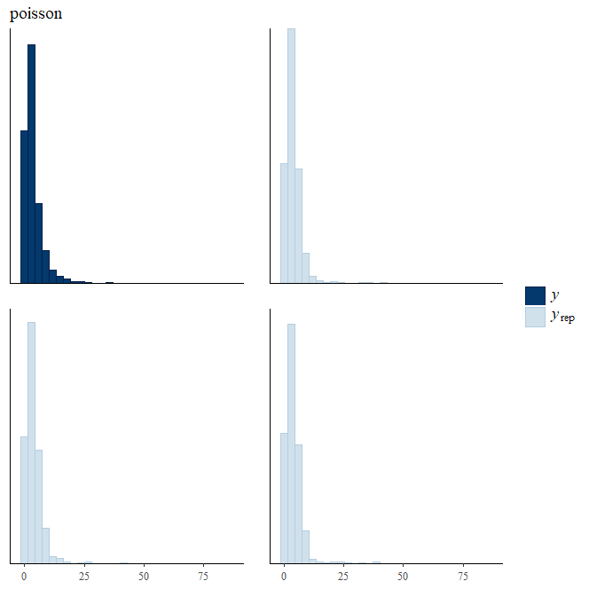
V2a: Model the difference in ring count from one section to the next (incremental ring counts are a priori independent);
likelihood = Poisson
ppc hist

Slide 34
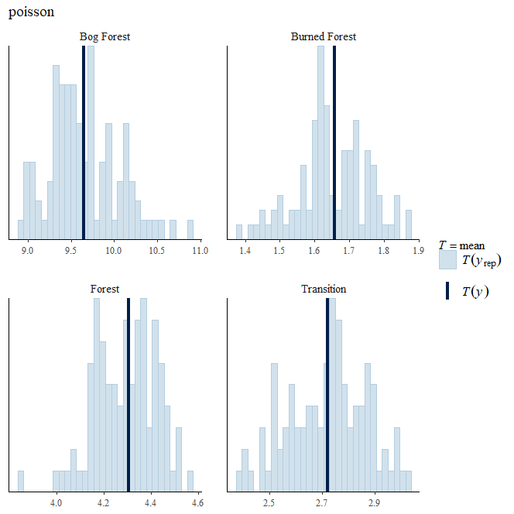
V2a: Model the difference in ring count from one section to the next (incremental ring counts are a priori independent);
likelihood = Poisson

Slide 35
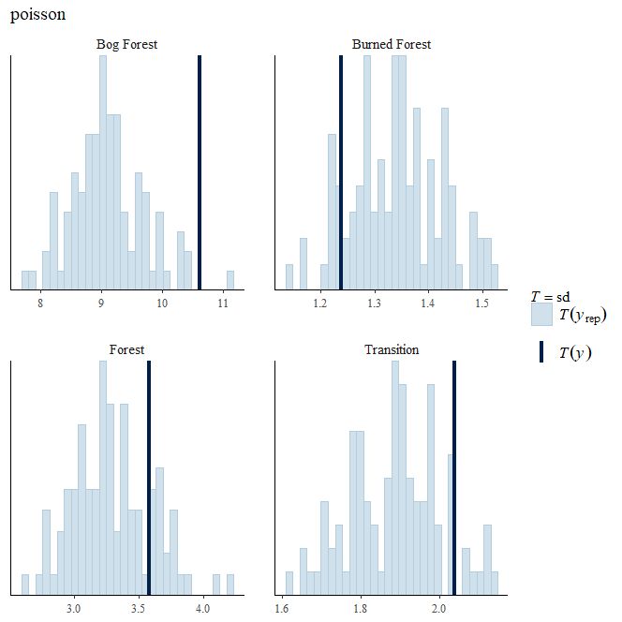
V2a: Model the difference in ring count from one section to the next (incremental ring counts are a priori independent);
likelihood = Poisson

Slide 36
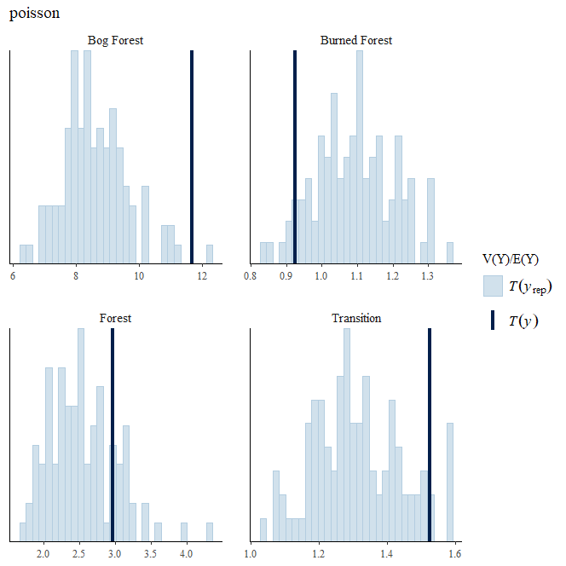
V2a: Model the difference in ring count from one section to the next (incremental ring counts are a priori independent);
likelihood = Poisson

Slide 37
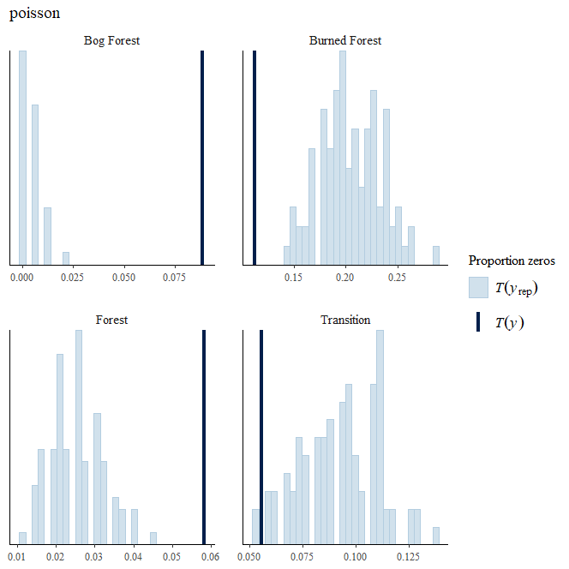
V2a: Model the difference in ring count from one section to the next (incremental ring counts are a priori independent);
likelihood = Poisson

Slide 38
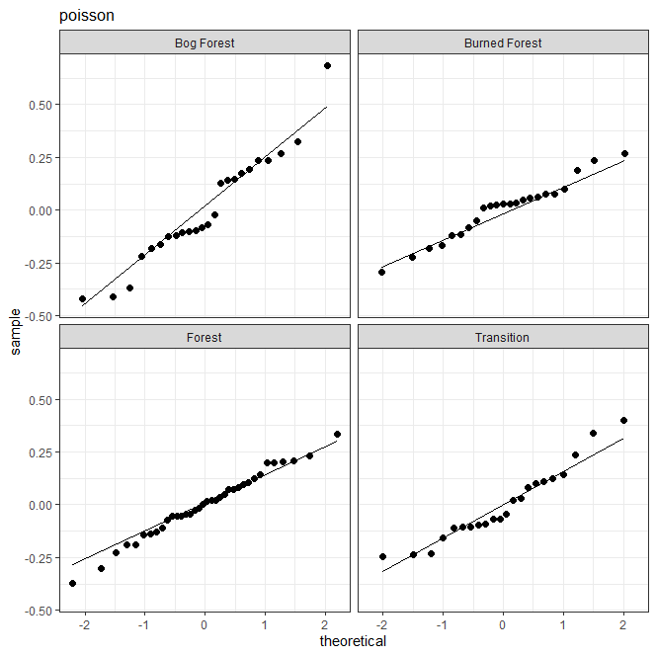
V2a: Model the difference in ring count from one section to the next (incremental ring counts are a priori independent);
likelihood = Poisson
Normal QQ plot of tree-level
random intercept point estimates

Slide 39
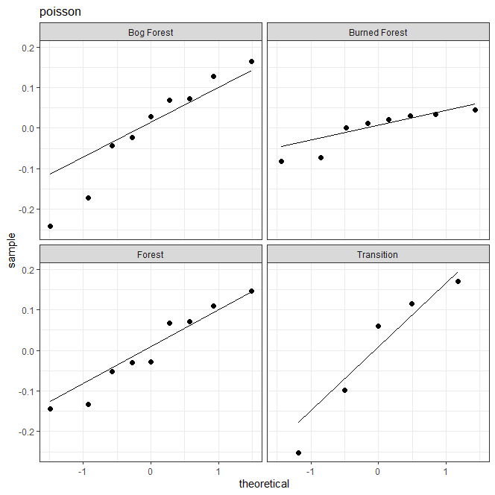
V2a: Model the difference in ring count from one section to the next (incremental ring counts are a priori independent);
likelihood = Poisson
Normal QQ plot of plot-level
random intercept point estimates

Slide 40
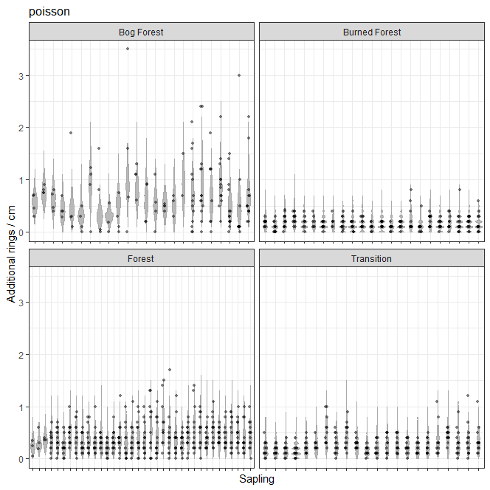
V2a: Model the difference in ring count from one section to the next (incremental ring counts are a priori independent);
likelihood = Poisson

Slide 41
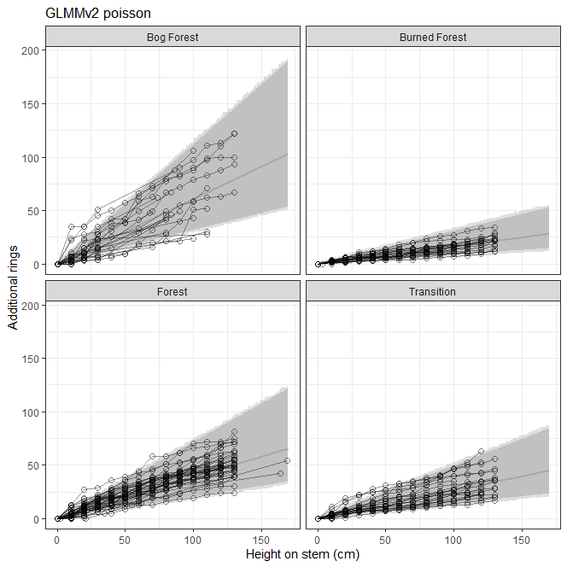
V2a: Model the difference in ring count from one section to the next (incremental ring counts are a priori independent);
likelihood = Poisson
Cumulative additional rings vs. height, grouped by patch;
dark inner shading = linear predictor (i.e., expected / fitted value of AddRings); light outer shading = PPD; 95% credible intervals
line = posterior median of the predicted values
Fitted values and PPD are integrated over the tree-level random slope – predictions are for an arbitrary unobserved tree
harv_GLMMv2_predict_AddRings.png

Slide 42
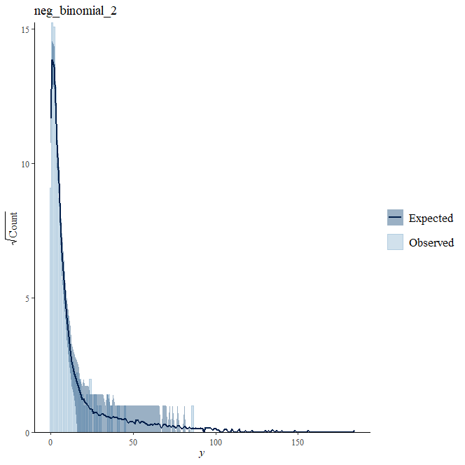
V2b: Model the difference in ring count from one section to the next (incremental ring counts are a priori independent);
likelihood = negative binomial
stan_glmer
family: neg_binomial_2 [log]
formula: DiffRings ~ Patch + (1 | Sapling) + (1 | Plot)
observations: 1113
------
Median MAD_SD
(Intercept) -0.412 0.082
PatchBurned Forest -1.381 0.119
PatchForest -0.516 0.108
PatchTransition -0.908 0.127
Auxiliary parameter(s):
Median MAD_SD
reciprocal_dispersion 3.879 0.341
Error terms:
Groups Name Std.Dev.
Sapling (Intercept) 0.1292
Plot (Intercept) 0.1736
Num. levels: Sapling 105, Plot 31

Slide 43
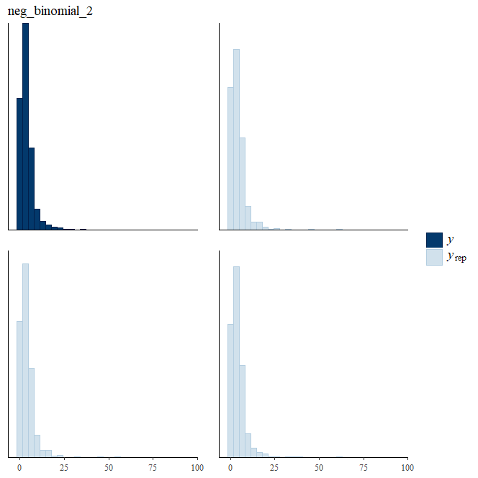
V2b: Model the difference in ring count from one section to the next (incremental ring counts are a priori independent);
likelihood = negative binomial

Slide 44
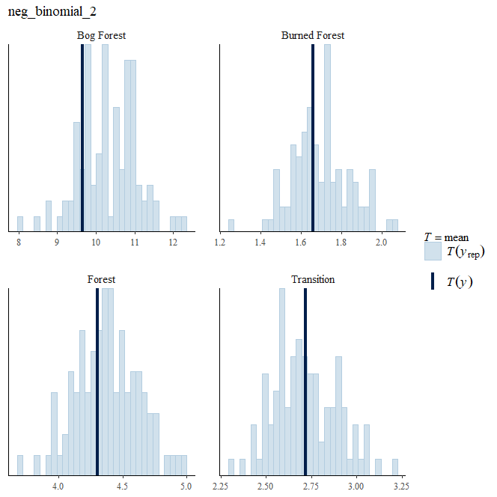
V2b: Model the difference in ring count from one section to the next (incremental ring counts are a priori independent);
likelihood = negative binomial

Slide 45
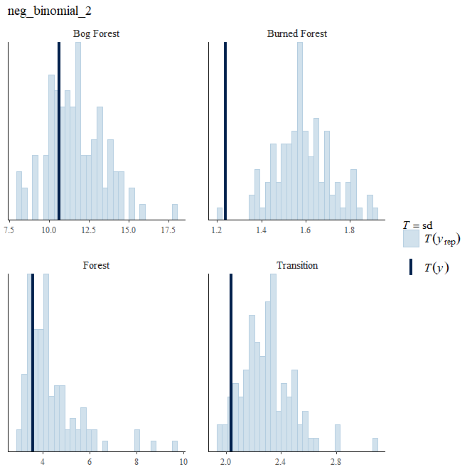
V2b: Model the difference in ring count from one section to the next (incremental ring counts are a priori independent);
likelihood = negative binomial

Slide 46
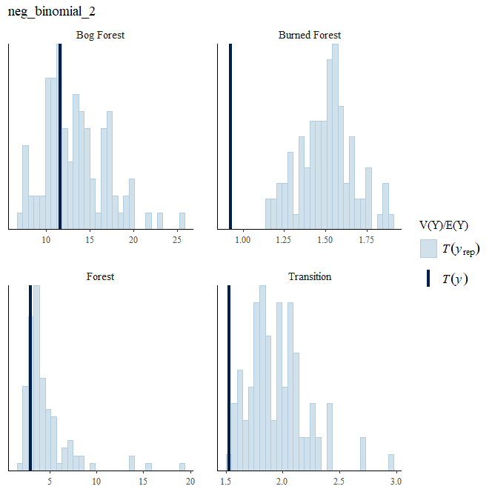
V2b: Model the difference in ring count from one section to the next (incremental ring counts are a priori independent);
likelihood = negative binomial

Slide 47
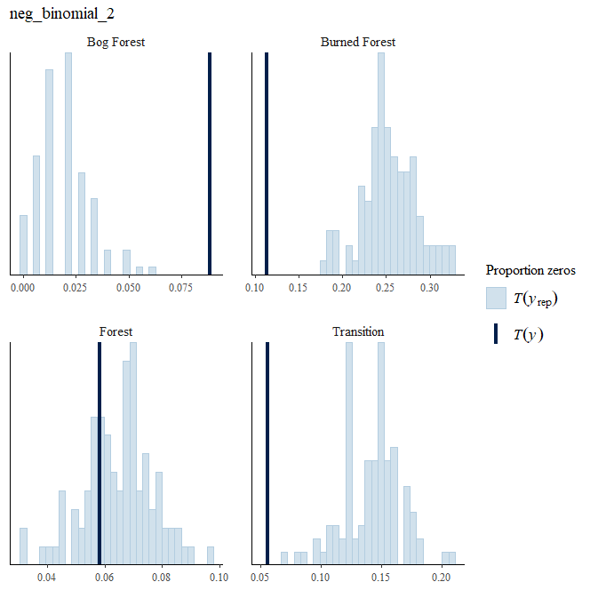
V2b: Model the difference in ring count from one section to the next (incremental ring counts are a priori independent);
likelihood = negative binomial

Slide 48
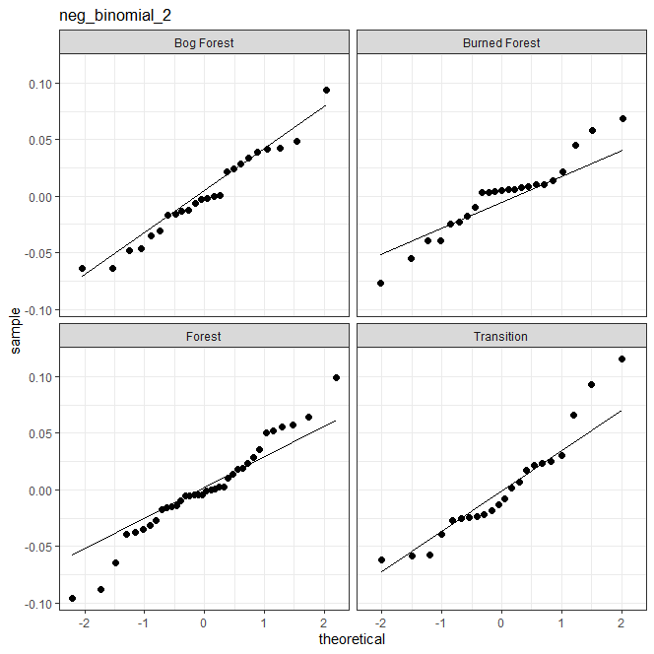
V2b: Model the difference in ring count from one section to the next (incremental ring counts are a priori independent);
likelihood = negative binomial
Normal QQ plot of tree-level
random intercept point estimates

Slide 49
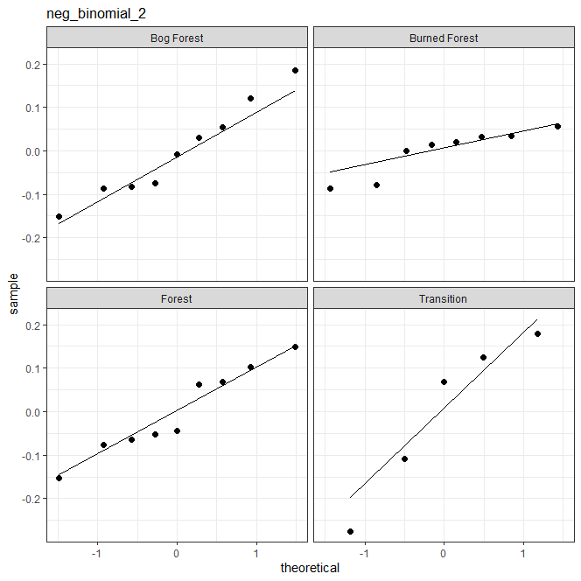
V2b: Model the difference in ring count from one section to the next (incremental ring counts are a priori independent);
likelihood = negative binomial
Normal QQ plot of plot-level
random intercept point estimates

Slide 50
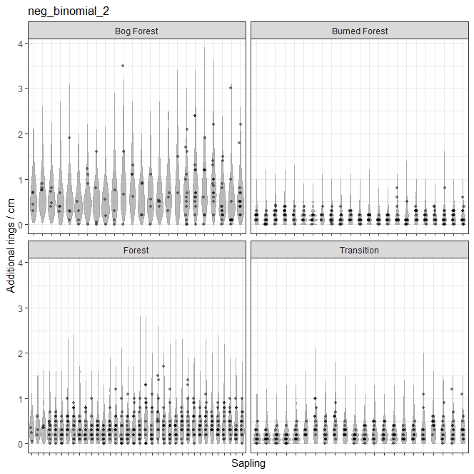
V2b: Model the difference in ring count from one section to the next (incremental ring counts are a priori independent);
likelihood = negative binomial

Slide 51
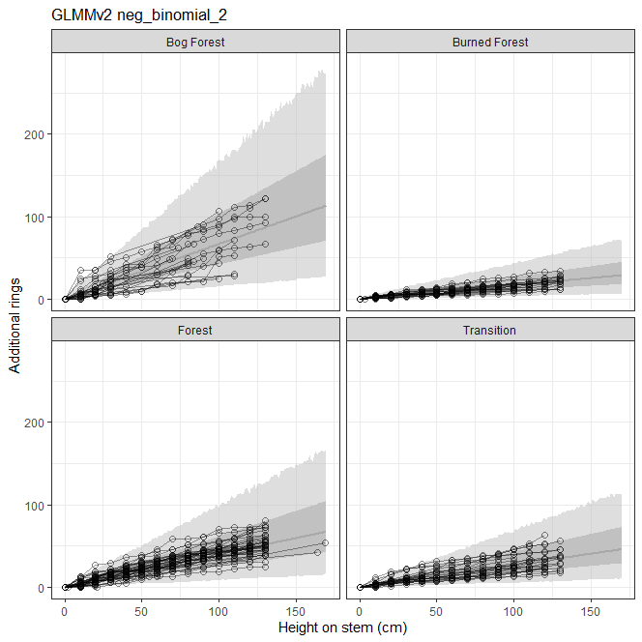
V2b: Model the difference in ring count from one section to the next (incremental ring counts are a priori independent);
likelihood = negative binomial
Cumulative additional rings vs. height, grouped by patch;
dark inner shading = linear predictor (i.e., expected / fitted value of AddRings); light outer shading = PPD; 95% credible intervals
line = posterior median of the predicted values
Fitted values and PPD are integrated over the tree-level random slope – predictions are for an arbitrary unobserved tree

Slide 52
V2a (Poisson likelihood) vs. V2b (negative binomial likelihood)
Computed from 6000 by 1113 log-likelihood matrix
Estimate SE
elpd_loo -2702.1 74.7
p_loo 181.7 20.4
looic 5404.1 149.4
------
Monte Carlo SE of elpd_loo is NA.
Pareto k diagnostic values:
Count Pct. Min. n_eff
(-Inf, 0.5] (good) 1093 98.2% 675
(0.5, 0.7] (ok) 6 0.5% 287
(0.7, 1] (bad) 9 0.8% 23
(1, Inf) (very bad) 5 0.4% 3
Computed from 6000 by 1113 log-likelihood matrix
Estimate SE
elpd_loo -2459.2 32.8
p_loo 40.2 3.7
looic 4918.4 65.6
------
Monte Carlo SE of elpd_loo is NA.
Pareto k diagnostic values:
Count Pct. Min. n_eff
(-Inf, 0.5] (good) 1109 99.6% 2640
(0.5, 0.7] (ok) 3 0.3% 377
(0.7, 1] (bad) 1 0.1% 58
(1, Inf) (very bad) 0 0.0% <NA>

Slide 53
V2a (Poisson likelihood) vs. V2b (negative binomial likelihood)
loo compare:
elpd_diff se_diff
harv_glmer2_nb 0.0 0.0
harv_glmer2_pois -242.9 47.7

Slide 54
Uncertainty of Duncan rings-to-pith estimates

Slide 55
Original Patch Type vs. Patch 2
(only affects 2 cores)
stan_lmer
family: gaussian [identity]
formula: log(width) ~ patch + (1 | tree)
observations: 366
------
Median MAD_SD
(Intercept) -2.00 0.12
patchBurned Forest 0.72 0.18
patchForest 0.57 0.16
patchTransition 1.51 0.17
Auxiliary parameter(s):
Median MAD_SD
sigma 0.28 0.01
Error terms:
Groups Name Std.Dev.
tree (Intercept) 0.640
Residual 0.281
Num. levels: tree 122
stan_lmer
family: gaussian [identity]
formula: log(width) ~ patch + (1 | tree)
observations: 366
------
Median MAD_SD
(Intercept) -2.00 0.12
patchBurned Forest 0.65 0.17
patchForest 0.57 0.16
patchTransition 1.50 0.17
Auxiliary parameter(s):
Median MAD_SD
sigma 0.28 0.01
Error terms:
Groups Name Std.Dev.
tree (Intercept) 0.634
Residual 0.281
Num. levels: tree 122

Slide 56
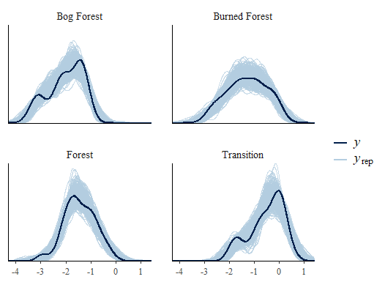
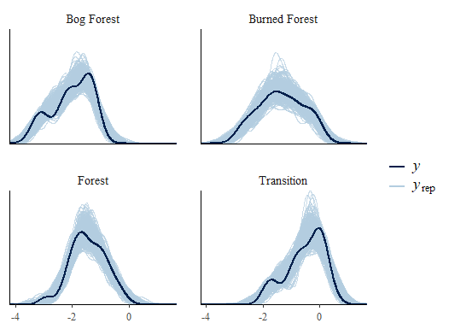
Original Patch Type vs. Patch 2
(only affects 2 cores)
PPC

Slide 57
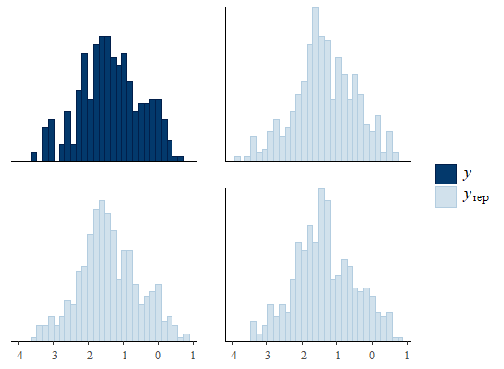
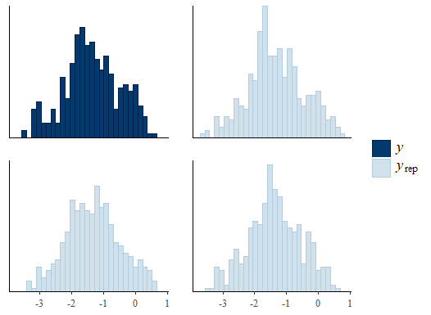
Original Patch Type vs. Patch 2
(only affects 2 cores)
PPC

Slide 58
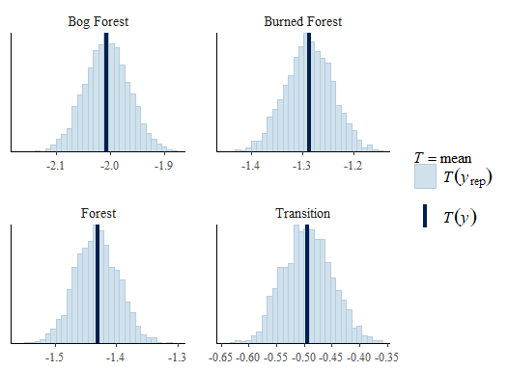
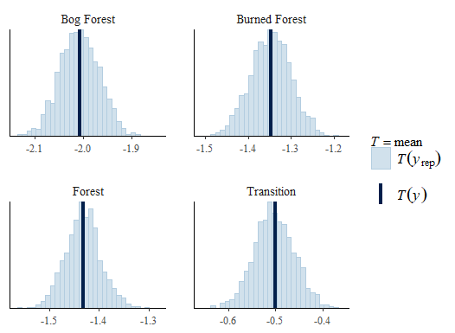
Original Patch Type vs. Patch 2
(only affects 2 cores)
PPC

Slide 59
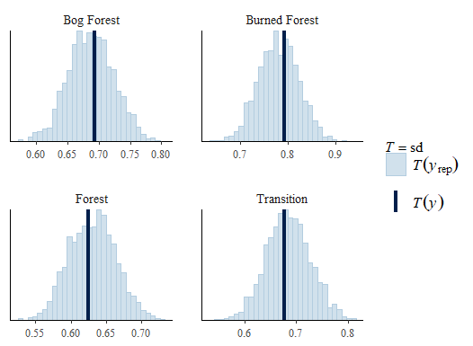
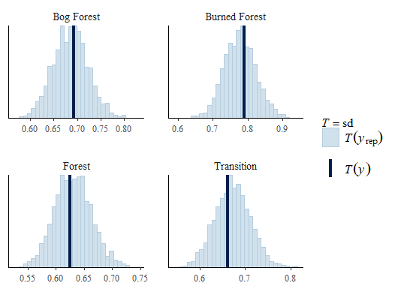
Original Patch Type vs. Patch 2
(only affects 2 cores)
PPC

Slide 60


Original Patch Type vs. Patch 2
(only affects 2 cores)
PPC

Slide 61


Original Patch Type vs. Patch 2
(only affects 2 cores)
PPC

Slide 62


Original Patch Type vs. Patch 2
(only affects 2 cores)
Dotplots of ring width by core w/ violin plots of PPD

Slide 63


Original Patch Type vs. Patch 2
(only affects 2 cores)
Credible intervals of posterior distribution of rings-to-pith estimates

Slide 64


Original Patch Type vs. Patch 2
(only affects 2 cores)
Joyplots of posterior distribution of rings-to-pith estimates

Slide 65
Summary of Bayesian approach for estimating tree establishment years:
Model-based posteriors of
1. Coring height corrections
2. Duncan rings to pith corrections
Prior on
3. Missing outer rings
Informative priors on
4. age/recruitment year of each tree
Reconstruct prior on
5. population-level annual recruitment

Slide 66
Summary of Bayesian approach for estimating tree establishment years:
Model-based posteriors of
1. Coring height corrections
2. Duncan rings to pith corrections
Prior on
3. Missing outer rings
Unresolved issues:
1a. Uncertainty in
coring height?
1b. observation-level
random effects should
be included in model?
Informative priors on
4. age/recruitment year of each tree
Reconstruct prior on
5. population-level annual recruitment

Slide 67

Posterior coring
height corrections:
Joyplots of posterior distribution of coring height corrections

Slide 68
2. Posterior Duncan rings to pith corrections:
Joyplots of posterior distribution of rings-to-pith estimates

